Slide 1
Computer Vision
Part 1: Filtering
ADF – Start 08:30

Slide 2

Agenda
Part 1: Filtering and Convolution
Convolution and Correlation
Smoothing Filter
Part 2: Edge Detection
Computer Vision

Slide 3
Convolution and Correlation
Computer Vision

Slide 4
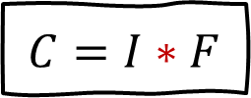
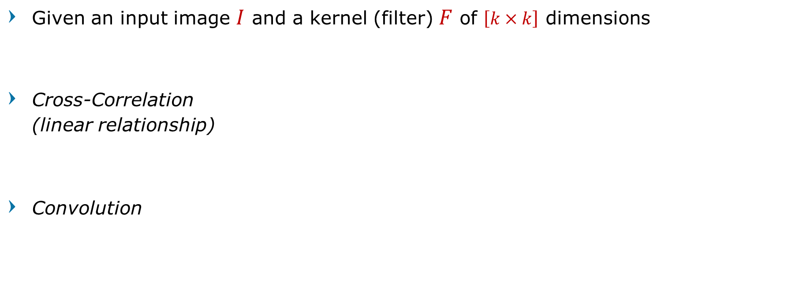
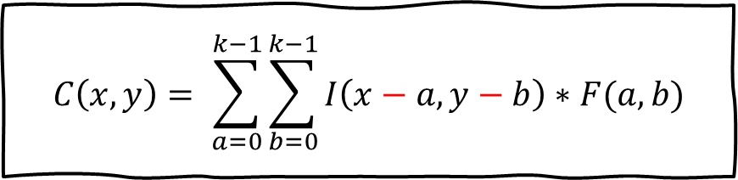
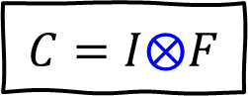
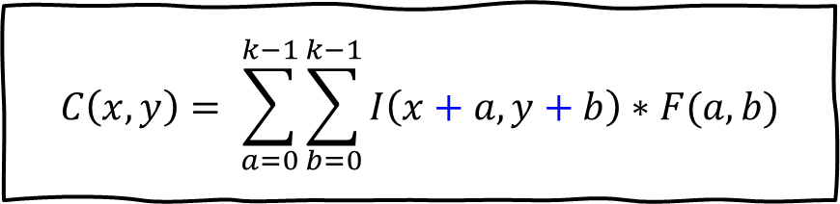
Convolution and Correlation
Given an input image $I$ and a kernel (filter) $F$ of $\left[k×k\right]$ dimensions
Cross-Correlation (linear relationship)
Convolution
$$C\left(x,y\right)= \sum_{a=0}^{k−1}{\sum_{b=0}^{k−1}{I\left(x+a, y+b\right)∗F(a,b)}}$$
$$C=I⨂F$$
$$C\left(x,y\right)= \sum_{a=0}^{k−1}{\sum_{b=0}^{k−1}{I\left(x−a, y−b\right)∗F(a,b)}}$$
$$C=I∗F$$
Computer Vision

Slide 5
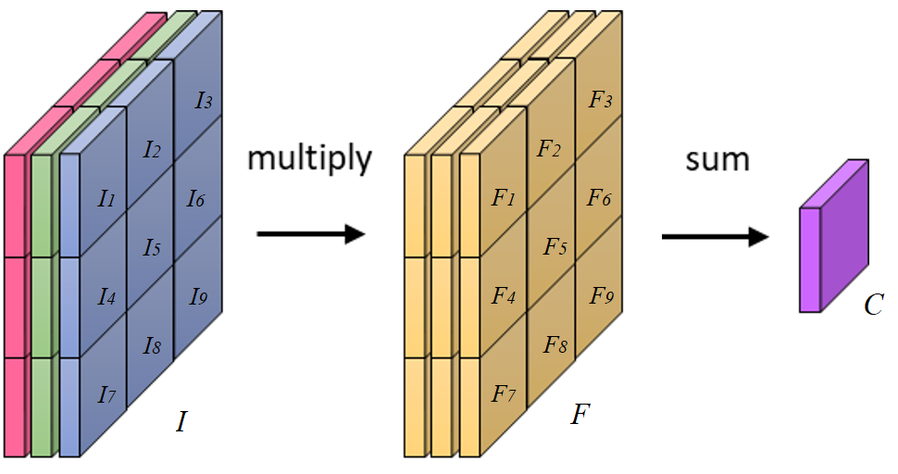

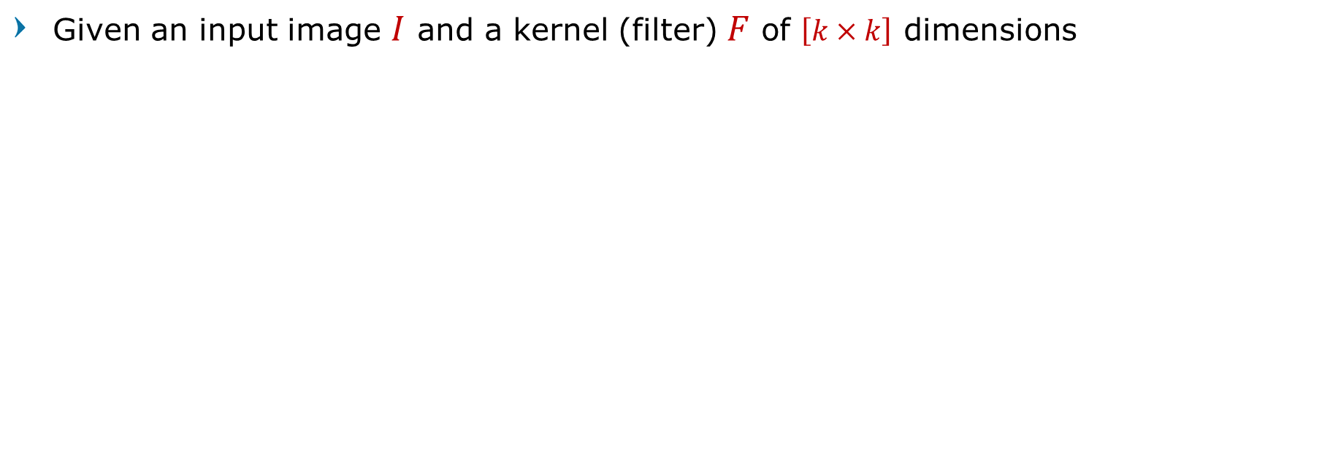
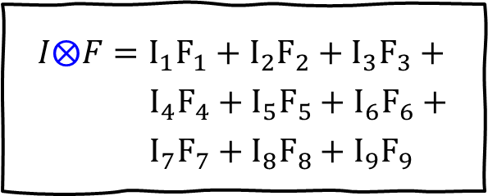
Correlation
Given an input image $I$ and a kernel (filter) $F$ of $\left[k×k\right]$ dimensions
$$C=I⨂F$$
$I⨂F=I_{1}F_{1}+I_{2}F_{2}+I_{3}F_{3}+$
$I_{4}F_{4}+I_{5}F_{5}+I_{6}F_{6}+$
$I_{7}F_{7}+I_{8}F_{8}+I_{9}F_{9}$
Computer Vision

Slide 6
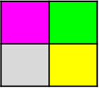

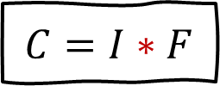
Correlation and Convolution
Convolution is the same as Cross-Correlation, except that the filter is "flipped"
Horizontally and vertically
180°
$$C=I∗F$$
1 | 2
3 | 4
4 | 3
2 | 1
$$C\left(x,y\right)= \sum_{a=0}^{k−1}{\sum_{b=0}^{k−1}{I\left(x−a, y−b\right)∗F(a,b)}}$$
flip
4 | 3
2 | 1
flip
Computer Vision

Slide 7

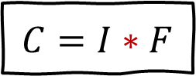
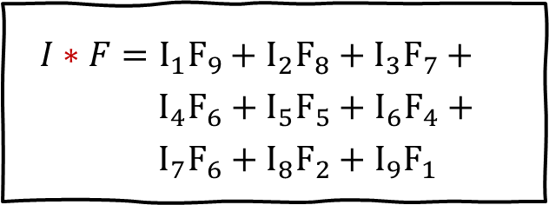
Convolution
Given an input image $I$ and a kernel (filter) $F$ of $\left[k×k\right]$ dimensions
$$C=I∗F$$
$I∗F=I_{1}F_{9}+I_{2}F_{8}+I_{3}F_{7}+$
$I_{4}F_{6}+I_{5}F_{5}+I_{6}F_{4}+$
$I_{7}F_{6}+I_{8}F_{2}+I_{9}F_{1}$
Computer Vision

Slide 8
Correlation and Convolution
Convolution is a filtering operation
expresses the amount of overlap of one function as it is shifted over another function
Correlation compares the similarity of two sets of data
relatedness of the signals!
Cross-Correlation
a measure of similarity of two series as a function of the displacement of one relative to the other
Computer Vision

Slide 9
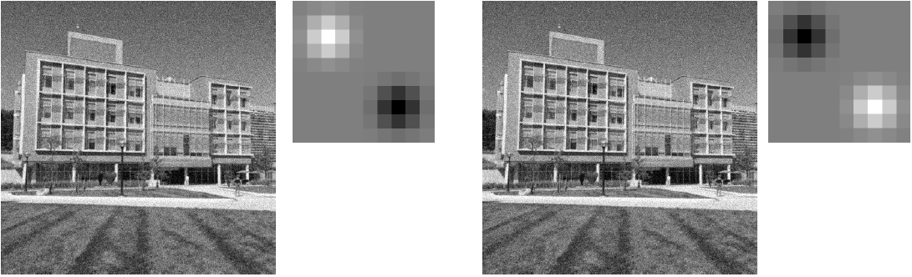
Cross-Correlation vs Convolution
Original Orientation
Flipped in x and y
Computer Vision

Slide 10
Aside: Cross-Correlation vs Convolution
Many machine learning libraries implement Cross-Correlation but call it Convolution
Using Cross-correlation
Intuitively it’s makes sense
The filter is using correlation to detect pattern
Easily visualized in their intuitive orientation
Computer Vision

Slide 11
Aside: Cross-Correlation vs Convolution
Mathematically, it’s wrong to say it Convolutional Neural Network
"Deep learning" is not the best field for rigorous definitions
Computer Vision

Slide 12
But then…
In Backpropagating Convolution, the backward pass is also a Convolution function
But we need to FLIP the filter
So it’s kind of the same process ¯\_(ツ)_/¯
Computer Vision

Slide 13
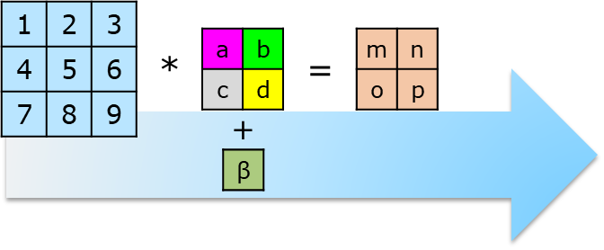
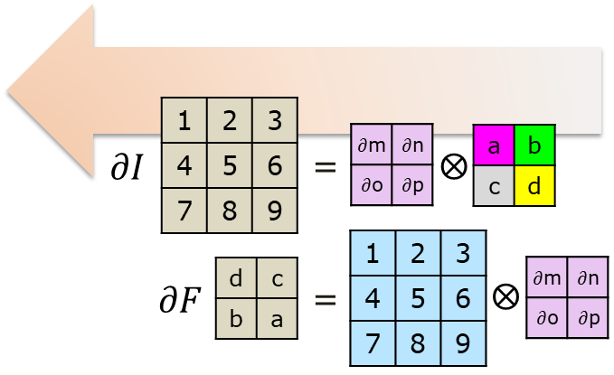
Forward - Backward
If the forward pass is a Convolution, then the backward pass is a Cross-correlation
If the forward pass is a Cross-correlation, then the backward pass is a Convolution
Computer Vision

Slide 14
Filtering
Computer Vision

Slide 15
Image Filtering
Compute function of local neighborhood at each position
Enhance images
Denoise, resize, increase contrast, etc.
Extract information from images
Texture, edges, distinctive points, etc.
Detect patterns
Template matching
Computer Vision

Slide 16
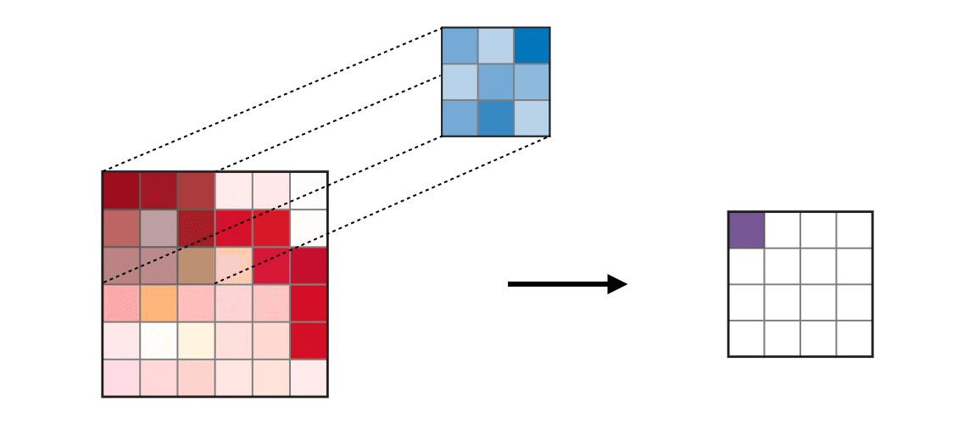
Filtering Process: Convolution or Correlation
Computer Vision

Slide 17
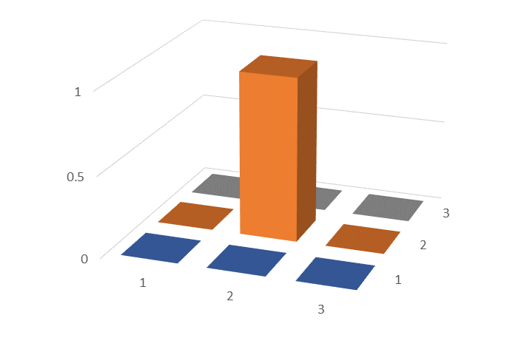
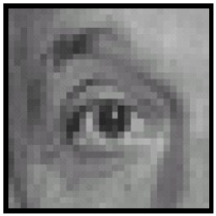



Linear Filters
0 | 0 | 0
0 | 1 | 0
0 | 0 | 0
$$⨂$$
$$=$$
Original
The Same
(Identity)
Computer Vision

Slide 18
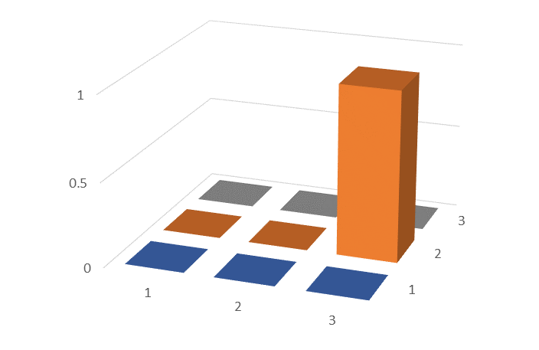
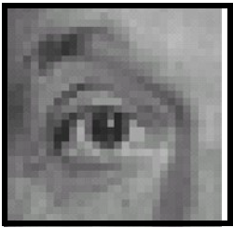
Linear Filters
0 | 0 | 0
0 | 0 | 1
0 | 0 | 0
$$⨂$$
$$=$$
Original
Shifted 1 pixel left
Computer Vision

Slide 19
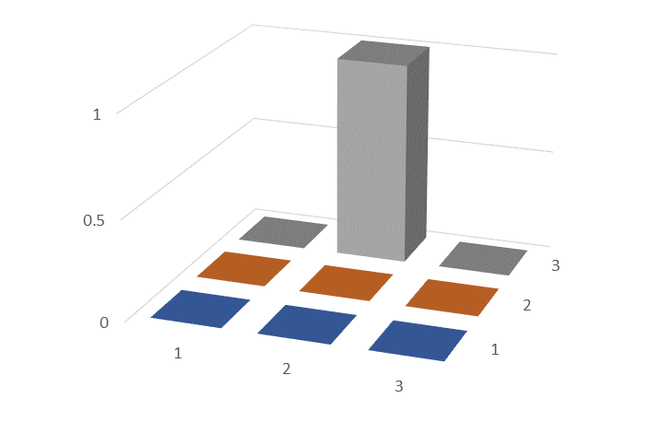
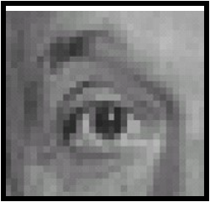
Linear Filters
0 | 1 | 0
0 | 0 | 0
0 | 0 | 0
$$⨂$$
$$=$$
Original
Shifted 1 pixel down
Computer Vision

Slide 20
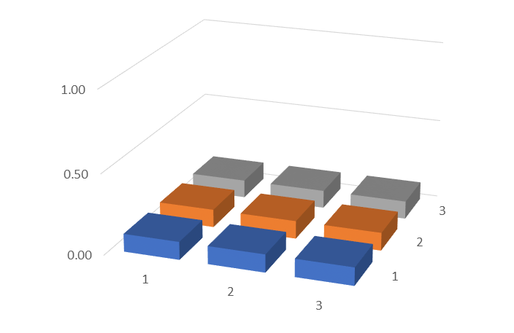
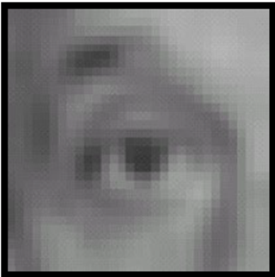
Linear Filters
1/9 | 1/9 | 1/9
1/9 | 1/9 | 1/9
1/9 | 1/9 | 1/9
$$⨂$$
$$=$$
Original
Blur
(Box Filter)
Computer Vision

Slide 21
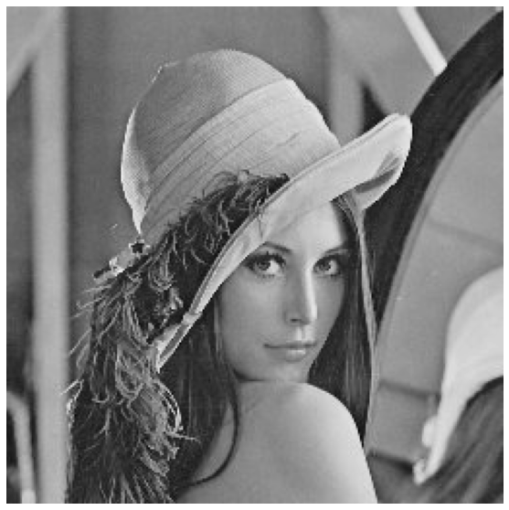
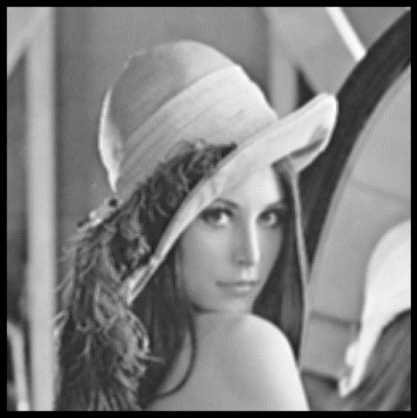


Linear Filters
1/9 | 1/9 | 1/9
1/9 | 1/9 | 1/9
1/9 | 1/9 | 1/9
$$⨂$$
$$=$$
Smoothed (3x3)
Original
Computer Vision

Slide 22
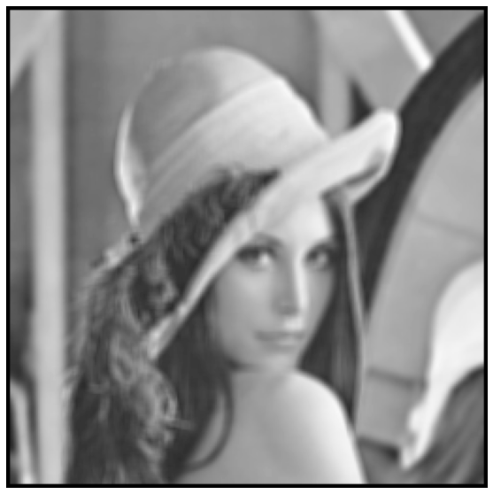

Linear Filters
1/25 | 1/25 | 1/25 | 1/25 | 1/25
1/25 | 1/25 | 1/25 | 1/25 | 1/25
1/25 | 1/25 | 1/25 | 1/25 | 1/25
1/25 | 1/25 | 1/25 | 1/25 | 1/25
1/25 | 1/25 | 1/25 | 1/25 | 1/25
$$⨂$$
$$=$$
Smoothed (5x5)
Original
Computer Vision

Slide 23
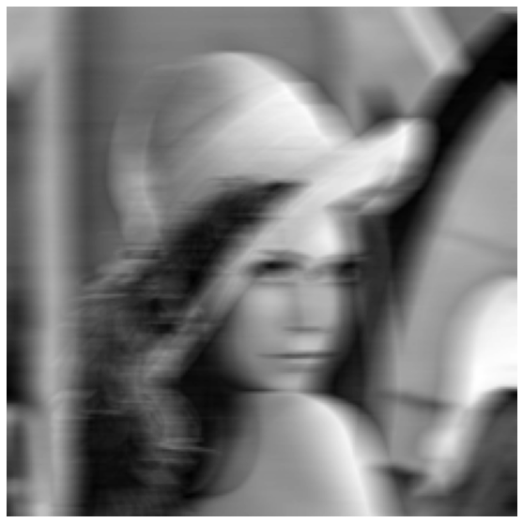
Linear Filters
$$⨂$$
1/9 | 1/9 | 1/9 | … | 1/9
$$=$$
Horizontal blur
Original
Computer Vision

Slide 24
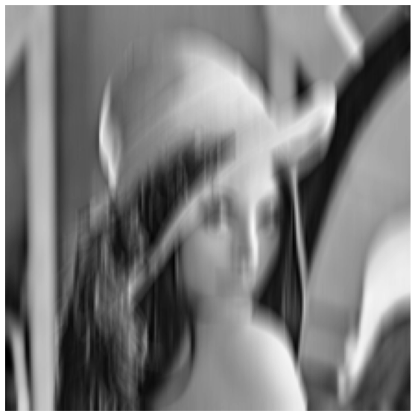
Linear Filters
1/9
1/9
1/9
…
1/9
$$⨂$$
$$=$$
Vertical blur
Original
Computer Vision

Slide 25
Combining Filters
Computer Vision

Slide 26
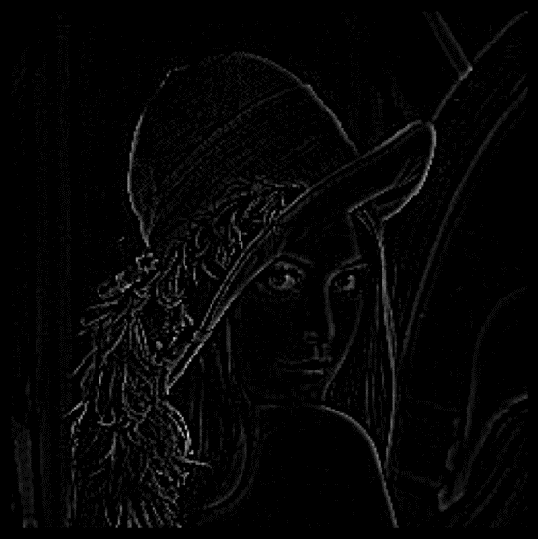
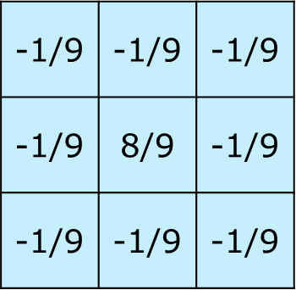



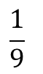

Combining Filters
detail
$$−$$
$$=$$
Original
Smoothed
0 | 0 | 0
0 | 1 | 0
0 | 0 | 0
1 | 1 | 1
1 | 1 | 1
1 | 1 | 1
$$−$$
$$\frac{1}{9}$$
$$=$$
Computer Vision

Slide 27
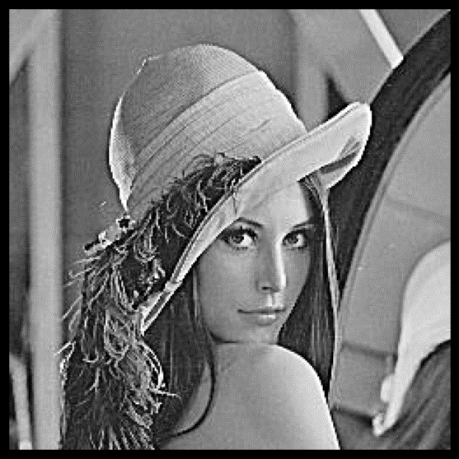

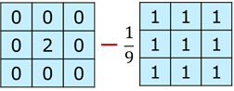
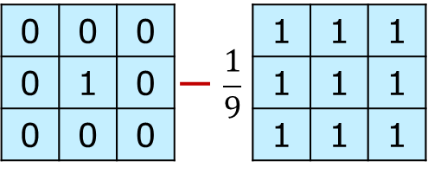


Combining Filters
sharpened
$$+$$
$$=$$
Original
detail
0 | 0 | 0
0 | 1 | 0
0 | 0 | 0
$$+$$
$$=$$
Computer Vision
Notes:
Acccentuates difference from local average)

Slide 28
Combining Filters
detail
$$−$$
$$=$$
Original
Smoothed (5x5)
0 | 0 | 0 | 0 | 0
0 | 0 | 0 | 0 | 0
0 | 0 | 1 | 0 | 0
0 | 0 | 0 | 0 | 0
0 | 0 | 0 | 0 | 0
1 | 1 | 1 | 1 | 1
1 | 1 | 1 | 1 | 1
1 | 1 | 1 | 1 | 1
1 | 1 | 1 | 1 | 1
1 | 1 | 1 | 1 | 1
-0.04 | -0.04 | -0.04 | -0.04 | -0.04
-0.04 | -0.04 | -0.04 | -0.04 | -0.04
-0.04 | -0.04 | 0.96 | -0.04 | -0.04
-0.04 | -0.04 | -0.04 | -0.04 | -0.04
-0.04 | -0.04 | -0.04 | -0.04 | -0.04
$$−$$
$$\frac{1}{25}$$
$$=$$
Computer Vision

Slide 29
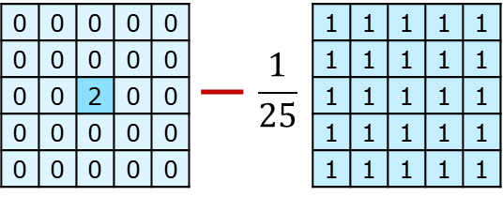

Combining Filters
sharpened
$$+$$
$$=$$
Original
detail
0 | 0 | 0 | 0 | 0
0 | 0 | 0 | 0 | 0
0 | 0 | 1 | 0 | 0
0 | 0 | 0 | 0 | 0
0 | 0 | 0 | 0 | 0
$$+$$
$$=$$
Computer Vision
Notes:
Acccentuates difference from local average)

Slide 30
Properties of Convolution
Computer Vision

Slide 31
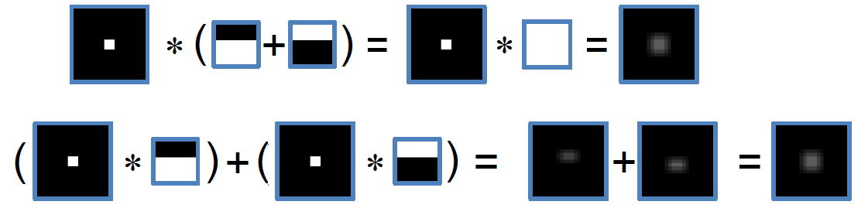
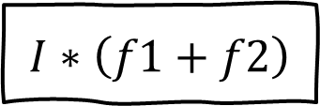

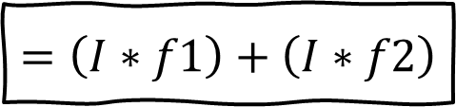
Linear Properties
Assume image $I$, and filters $f1$, $f2$
$$I∗\left(f1+f2\right)$$
$$=\left(I∗f1\right)+\left(I∗f2\right)$$
Computer Vision

Slide 32
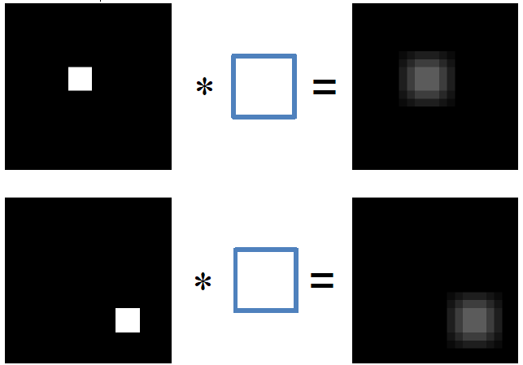
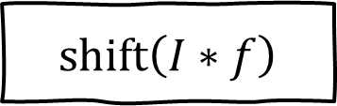

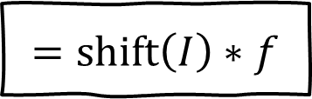
Shift-Invariant Properties
Assume image $I$, and filters $f$
$$\text{shift}\left(I∗f\right)$$
$$=\text{shift}\left(I\right)∗f$$
Computer Vision

Slide 33
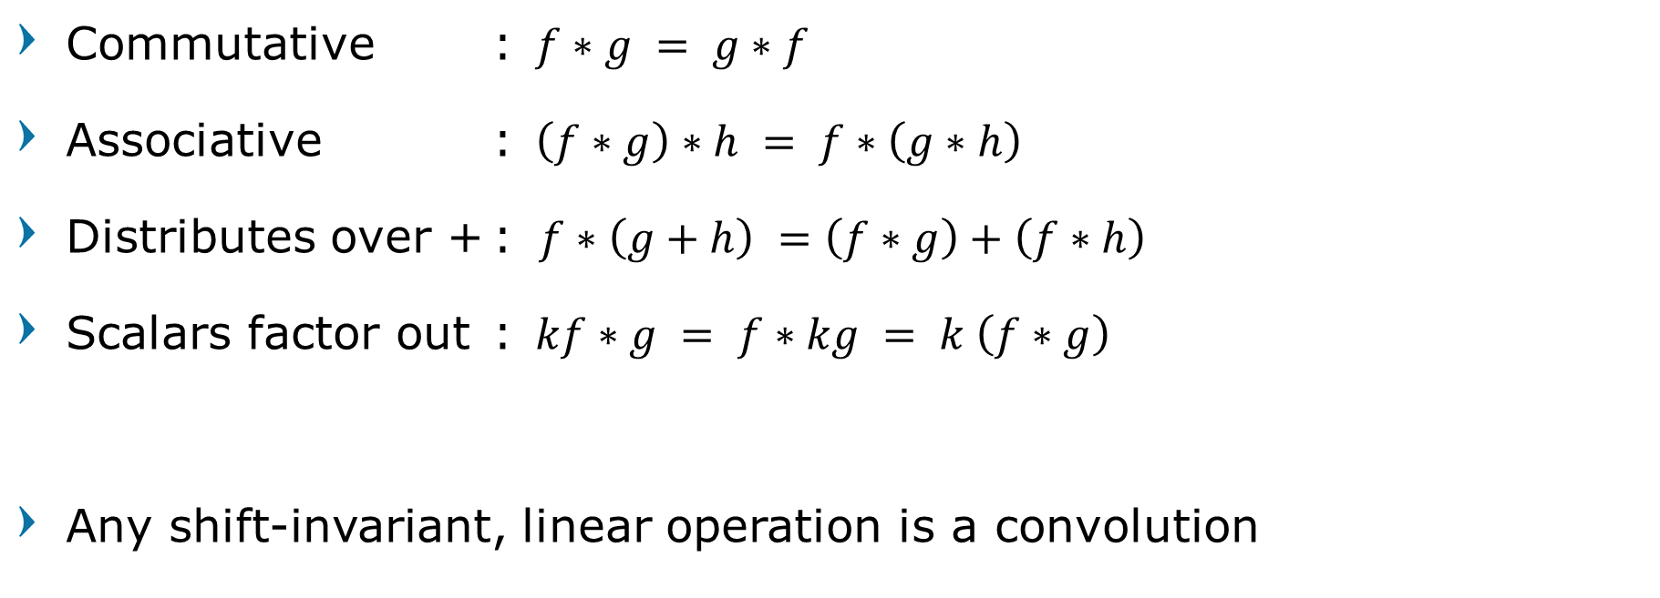
Properties of Convolution
Commutative : $f∗g = g∗f$
Associative : $\left(f∗g\right)∗h = f∗\left(g∗h\right)$
Distributes over + : $f∗\left(g+h\right) =\left(f∗g\right)+\left(f∗h\right)$
Scalars factor out : $kf∗g = f∗kg = k \left(f∗g\right)$
Any shift-invariant, linear operation is a convolution
Computer Vision

Slide 34
Image Noise
Computer Vision

Slide 35
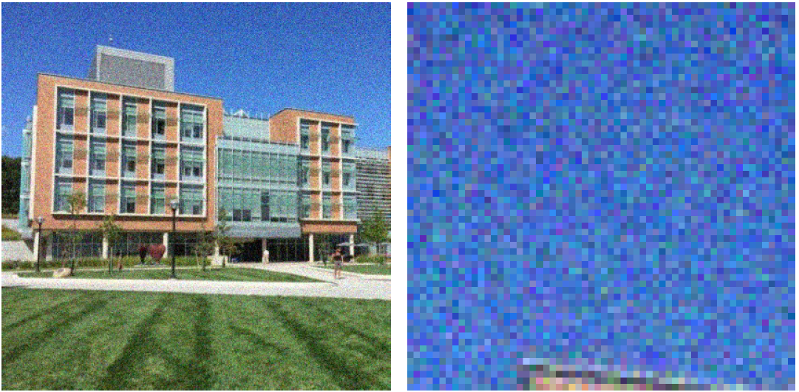
Image Noise
Computer Vision

Slide 36
Image Noise
Light Variations
Camera Electronics
Surface Reflectance
Lens
Noise is random,
it occurs with some probability
It has a distribution
Computer Vision

Slide 37
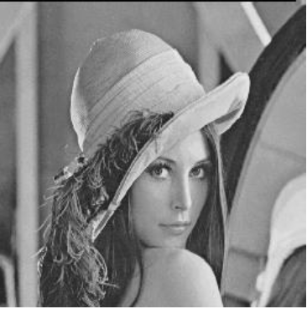
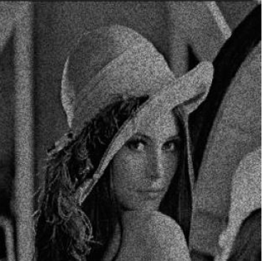


Image Noise
Original
Additive
(gaussian)
Multiplicative
(gaussian)
Salt and Pepper
(uniform)
How to fix these?
Computer Vision

Slide 38
Box Blur
Computer Vision

Slide 39
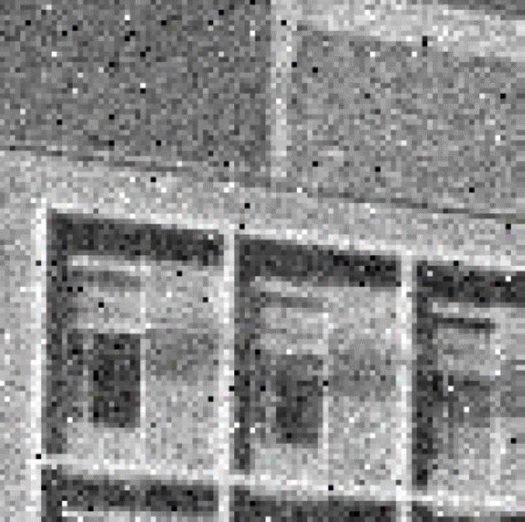
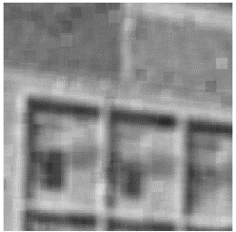
Box (Average) Smoothing
Replaces each pixel with an average of its neighborhood
Intuition: if filter touches it, it gets a contribution.
Computer Vision

Slide 40



Box (Average) Smoothing
1/9 | 1/9 | 1/9
1/9 | 1/9 | 1/9
1/9 | 1/9 | 1/9
$$∗$$
$$=$$
Smoothed (3x3)
Image + Gaussian Noise
Computer Vision

Slide 41
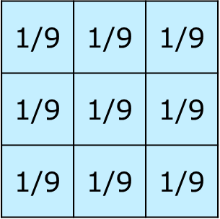

Box (Average) Smoothing
0 | 0 | 0 | 0 | 0 | 0 | 0 | 0 | 0 | 0
0 | 0 | 0 | 0 | 0 | 0 | 0 | 0 | 0 | 0
0 | 0 | 0 | 90 | 90 | 90 | 90 | 90 | 0 | 0
0 | 0 | 0 | 90 | 90 | 90 | 90 | 90 | 0 | 0
0 | 0 | 0 | 90 | 90 | 90 | 90 | 90 | 0 | 0
0 | 0 | 0 | 90 | 0 | 90 | 90 | 90 | 0 | 0
0 | 0 | 0 | 90 | 90 | 90 | 90 | 90 | 0 | 0
0 | 0 | 0 | 0 | 0 | 0 | 0 | 0 | 0 | 0
0 | 0 | 90 | 0 | 0 | 0 | 0 | 0 | 0 | 0
0 | 0 | 0 | 0 | 0 | 0 | 0 | 0 | 0 | 0
$$∗$$
$$=$$
Computer Vision

Slide 42
Box (Average) Smoothing
0 | 0 | 0 | 0 | 0 | 0 | 0 | 0 | 0 | 0
0 | 0 | 0 | 0 | 0 | 0 | 0 | 0 | 0 | 0
0 | 0 | 0 | 90 | 90 | 90 | 90 | 90 | 0 | 0
0 | 0 | 0 | 90 | 90 | 90 | 90 | 90 | 0 | 0
0 | 0 | 0 | 90 | 90 | 90 | 90 | 90 | 0 | 0
0 | 0 | 0 | 90 | 0 | 90 | 90 | 90 | 0 | 0
0 | 0 | 0 | 90 | 90 | 90 | 90 | 90 | 0 | 0
0 | 0 | 0 | 0 | 0 | 0 | 0 | 0 | 0 | 0
0 | 0 | 90 | 0 | 0 | 0 | 0 | 0 | 0 | 0
0 | 0 | 0 | 0 | 0 | 0 | 0 | 0 | 0 | 0
$$∗$$
$$=$$
0
Computer Vision

Slide 43
Box (Average) Smoothing
0 | 0 | 0 | 0 | 0 | 0 | 0 | 0 | 0 | 0
0 | 0 | 0 | 0 | 0 | 0 | 0 | 0 | 0 | 0
0 | 0 | 0 | 90 | 90 | 90 | 90 | 90 | 0 | 0
0 | 0 | 0 | 90 | 90 | 90 | 90 | 90 | 0 | 0
0 | 0 | 0 | 90 | 90 | 90 | 90 | 90 | 0 | 0
0 | 0 | 0 | 90 | 0 | 90 | 90 | 90 | 0 | 0
0 | 0 | 0 | 90 | 90 | 90 | 90 | 90 | 0 | 0
0 | 0 | 0 | 0 | 0 | 0 | 0 | 0 | 0 | 0
0 | 0 | 90 | 0 | 0 | 0 | 0 | 0 | 0 | 0
0 | 0 | 0 | 0 | 0 | 0 | 0 | 0 | 0 | 0
 | 0
$$∗$$
$$=$$
10
Computer Vision

Slide 44
Box (Average) Smoothing
0 | 0 | 0 | 0 | 0 | 0 | 0 | 0 | 0 | 0
0 | 0 | 0 | 0 | 0 | 0 | 0 | 0 | 0 | 0
0 | 0 | 0 | 90 | 90 | 90 | 90 | 90 | 0 | 0
0 | 0 | 0 | 90 | 90 | 90 | 90 | 90 | 0 | 0
0 | 0 | 0 | 90 | 90 | 90 | 90 | 90 | 0 | 0
0 | 0 | 0 | 90 | 0 | 90 | 90 | 90 | 0 | 0
0 | 0 | 0 | 90 | 90 | 90 | 90 | 90 | 0 | 0
0 | 0 | 0 | 0 | 0 | 0 | 0 | 0 | 0 | 0
0 | 0 | 90 | 0 | 0 | 0 | 0 | 0 | 0 | 0
0 | 0 | 0 | 0 | 0 | 0 | 0 | 0 | 0 | 0
 | 0 | 10
$$∗$$
$$=$$
20
Computer Vision

Slide 45
Box (Average) Smoothing
0 | 0 | 0 | 0 | 0 | 0 | 0 | 0 | 0 | 0
0 | 0 | 0 | 0 | 0 | 0 | 0 | 0 | 0 | 0
0 | 0 | 0 | 90 | 90 | 90 | 90 | 90 | 0 | 0
0 | 0 | 0 | 90 | 90 | 90 | 90 | 90 | 0 | 0
0 | 0 | 0 | 90 | 90 | 90 | 90 | 90 | 0 | 0
0 | 0 | 0 | 90 | 0 | 90 | 90 | 90 | 0 | 0
0 | 0 | 0 | 90 | 90 | 90 | 90 | 90 | 0 | 0
0 | 0 | 0 | 0 | 0 | 0 | 0 | 0 | 0 | 0
0 | 0 | 90 | 0 | 0 | 0 | 0 | 0 | 0 | 0
0 | 0 | 0 | 0 | 0 | 0 | 0 | 0 | 0 | 0
 | 0 | 10 | 20
$$∗$$
$$=$$
50
Computer Vision

Slide 46
Box (Average) Smoothing
0 | 0 | 0 | 0 | 0 | 0 | 0 | 0 | 0 | 0
0 | 0 | 0 | 0 | 0 | 0 | 0 | 0 | 0 | 0
0 | 0 | 0 | 90 | 90 | 90 | 90 | 90 | 0 | 0
0 | 0 | 0 | 90 | 90 | 90 | 90 | 90 | 0 | 0
0 | 0 | 0 | 90 | 90 | 90 | 90 | 90 | 0 | 0
0 | 0 | 0 | 90 | 0 | 90 | 90 | 90 | 0 | 0
0 | 0 | 0 | 90 | 90 | 90 | 90 | 90 | 0 | 0
0 | 0 | 0 | 0 | 0 | 0 | 0 | 0 | 0 | 0
0 | 0 | 90 | 0 | 0 | 0 | 0 | 0 | 0 | 0
0 | 0 | 0 | 0 | 0 | 0 | 0 | 0 | 0 | 0
 | 0 | 10 | 20
 |  |  |  | 50
$$∗$$
$$=$$
90
Computer Vision

Slide 47
Box (Average) Smoothing
0 | 0 | 0 | 0 | 0 | 0 | 0 | 0 | 0 | 0
0 | 0 | 0 | 0 | 0 | 0 | 0 | 0 | 0 | 0
0 | 0 | 0 | 90 | 90 | 90 | 90 | 90 | 0 | 0
0 | 0 | 0 | 90 | 90 | 90 | 90 | 90 | 0 | 0
0 | 0 | 0 | 90 | 90 | 90 | 90 | 90 | 0 | 0
0 | 0 | 0 | 90 | 0 | 90 | 90 | 90 | 0 | 0
0 | 0 | 0 | 90 | 90 | 90 | 90 | 90 | 0 | 0
0 | 0 | 0 | 0 | 0 | 0 | 0 | 0 | 0 | 0
0 | 0 | 90 | 0 | 0 | 0 | 0 | 0 | 0 | 0
0 | 0 | 0 | 0 | 0 | 0 | 0 | 0 | 0 | 0
 | 0 | 10 | 20 | 30 | 30 | 30 | 20 | 10
 | 0 | 20 | 40 | 60 | 60 | 60 | 40 | 20
 | 0 | 30 | 60 | 90 | 90 | 90 | 60 | 30
 | 0 | 30 | 50 | 80 | 80 | 90 | 60 | 30
 | 0 | 30 | 50 | 80 | 80 | 90 | 60 | 30
 | 0 | 20 | 30 | 50 | 50 | 60 | 40 | 20
 | 10 | 20 | 30 | 30 | 30 | 30 | 20 | 10
 | 10 | 10 | 10 | 0 | 0 | 0 | 0 | 0
$$∗$$
$$=$$
Computer Vision

Slide 48
Handling boundaries
Input
Output
Computer Vision

Slide 49

Box (Average) Smoothing
1/25 | 1/25 | 1/25 | 1/25 | 1/25
1/25 | 1/25 | 1/25 | 1/25 | 1/25
1/25 | 1/25 | 1/25 | 1/25 | 1/25
1/25 | 1/25 | 1/25 | 1/25 | 1/25
1/25 | 1/25 | 1/25 | 1/25 | 1/25
$$∗$$
$$=$$
Smoothed (5x5)
Image + Gaussian Noise
Computer Vision

Slide 50
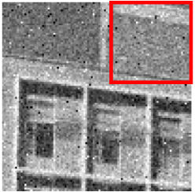


Box (Average) Smoothing Problem
Low-pass filter,
A single pixel with a very unrepresentative value can significantly affect the mean value of all the pixels in its neighborhood.
Computer Vision
Notes:
Low-pass filter, reduces the spatial intensity derivatives in the image
interpolate new values for pixels on the edge and so will blur that edge

Slide 51




Solution: Weighted Combination
Intuition: weight contributions according to closeness to center.
$$F∝\exp\left(−\frac{x^{2}+y^{2}}{2σ^{2}}\right)$$
$$F∝1$$
Computer Vision

Slide 52
Gaussian Blur
Computer Vision

Slide 53



Gaussian Blur
0.004 | 0.015 | 0.026 | 0.015 | 0.004
0.015 | 0.059 | 0.092 | 0.059 | 0.015
0.026 | 0.095 | 0.150 | 0.095 | 0.026
0.015 | 0.059 | 0.092 | 0.059 | 0.015
0.004 | 0.015 | 0.026 | 0.015 | 0.004
$$F∝\frac{1}{2πσ^{2}}\exp\left(−\frac{x^{2}+y^{2}}{2σ^{2}}\right)$$
Computer Vision

Slide 54



Gaussian Blur
$$∗$$
$$=$$
Gaussian Smoothing
Image + Gaussian Noise
Computer Vision

Slide 55
Box (Average) vs Gaussian Smoothing
Box Filter
Original
Gaussian Filter
Computer Vision
Notes:
Still have some speckles, but it’s not a big box

Slide 56

Box (Average) vs Gaussian Smoothing
Image + Gaussian Noise
Box Filter
Gaussian Filter
Computer Vision

Slide 57

Gaussian Filters
Computer Vision

Slide 58


Gaussian Filters
Computer Vision

Slide 59
Applying Gaussian Filters
Computer Vision

Slide 60

Applying Gaussian Filters
$$σ=1$$
Computer Vision

Slide 61

Applying Gaussian Filters
$$σ=2$$
Computer Vision

Slide 62

Applying Gaussian Filters
$$σ=4$$
Computer Vision

Slide 63
Gaussian Filters Problem
Gaussian filtering removes parts of the signal above a certain frequency.
Often noise is high frequency and signal is low frequency.
Fail when the noise distribution is not Gaussian
Computer Vision

Slide 64
Where Gaussian Fails
Computer Vision

Slide 65
Where Gaussian Fails
$$σ=1$$
Computer Vision

Slide 66
Gaussian Filters Problem
Means can be arbitrarily distorted by outliers
What else is an “average” other than a mean?
Signal
10 | 12 | 9 | 8 | 1000 | 11 | 10 | 12
Filter
0.1 | 0.8 | 0.1
Output
12 | 9 | 107 | 802 | 110 | 10
Computer Vision

Slide 67
Median Filter
Computer Vision

Slide 68
Non-Linear Filter (2D)
40 | 81 | 13 | 22
125 | 830 | 76 | 80
144 | 92 | 108 | 95
132 | 102 | 106 | 87
40 | 81 | 13 | 125 | 830 | 76 | 144 | 92 | 108
92 | 81
108 | 95
Sort
13 | 40 | 76 | 81 | 92 | 108 | 125 | 144 | 830
median
92
Computer Vision

Slide 69
Applying Median Filter
Median
size=3
Computer Vision

Slide 70
Applying Median Filter
Median
size=7
Computer Vision

Slide 71

Break, Question?
Computer Vision

